Slide 1
John 1.1: Ἐν ἀρχῇ ἦν ὁ λόγος:
In the beginning was the Word…
Image from clemsoncc.blogspot.com

Slide 2
John 1.1: Ἐν ἀρχῇ ἦν ὁ λόγος:
In the beginning was the Word…
revelation of God
to Jews
eternal reason
to Greeks

Slide 3
John 1.1-2: In the beginning was the Word, and the Word was with God, and the Word was fully God. The Word was with God in the beginning.

Slide 4
John 1.1-2: In the beginning was the Word, and the Word was with God, and the Word was fully God. The Word was with God in the beginning.
impersonal Word
to Greeks
singular God
to Jews

Slide 5
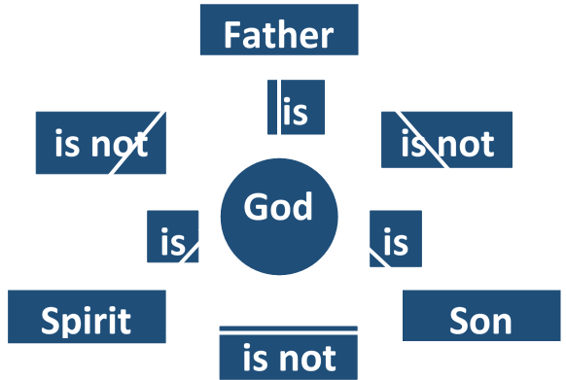

Slide 6
Trinitarianism
god 1
god 2
Tri-theism
god 3

Slide 7
Trinitarianism
Created Son
God
Arianism
Created Spirit

Slide 8
Trinitarianism
appears
Father
appears
God
Modalism
Son
Spirit
appears

Slide 9
Matthew 28.18-20 [NASB]: “And Jesus came up and spoke to them, saying, ‘All authority has been given to Me in heaven and on earth. Go therefore and make disciples of all the nations, baptizing them in the name of the Father and the Son and the Holy Spirit, teaching them to observe all that I commanded you; and lo, I am with you always, even to the end of the age.’”

Slide 10
Matthew 3.16-17 NET: “After Jesus was baptized, just as he was coming up out of the water, the heavens opened and he saw the Spirit of God descending like a dove and coming on him. And a voice from heaven [God’s voice] said, ‘This is my one dear Son; in him I take great delight.’”

Slide 11
2 Corinthians 13.14 NIV: “May the grace of the Lord Jesus Christ, and the love of God, and the fellowship of the Holy Spirit be with you all.”

Slide 12
John 14.16-17 NET: “Then I [Jesus] will ask the Father, and he will give you another Advocate to be with you forever– the Spirit of truth, whom the world cannot accept, because it does not see him or know him. But you know him, because he resides with you and will be in you.”

Slide 13
John 10.27-30 NASB, Jesus speaking: “My sheep hear My voice, and I know them, and they follow Me; and I give eternal life to them, and they will never perish; and no one will snatch them out of My hand. My Father, who has given them to Me, is greater than all; and no one is able to snatch them out of the Father's hand. I and the Father are one.”

Slide 14
Acts 5.1-4 NET: Now a man named Ananias, together with Sapphira his wife, sold a piece of property. He kept back for himself part of the proceeds with his wife's knowledge; he brought only part of it and placed it at the apostles' feet. But Peter said, "Ananias, why has Satan filled your heart to lie to the Holy Spirit and keep back for yourself part of the proceeds from the sale of the land? Before it was sold, did it not belong to you? And when it was sold, was the money not at your disposal? How have you thought up this deed in your heart? You have not lied to people but to God!"

Slide 15
Trinitarianism
There is one God, who has revealed himself as three individuals, distinct from each other in personality and function, but so unified in essence and will as to be considered one God: The Father, the Son, and the Holy Spirit, each all of the one God yet not the same as each other.

